Slide 1
CS 626 Project :
Multilingual Multitask Zero shot Generalization in Encoders via Statement Tuning
Team 66:
Annant Jain, 210110024
Pranjal, 210100117
Subram Das, 210100153
Hanish, 210100060
28/11/24
Notes:
‹#›

Slide 2
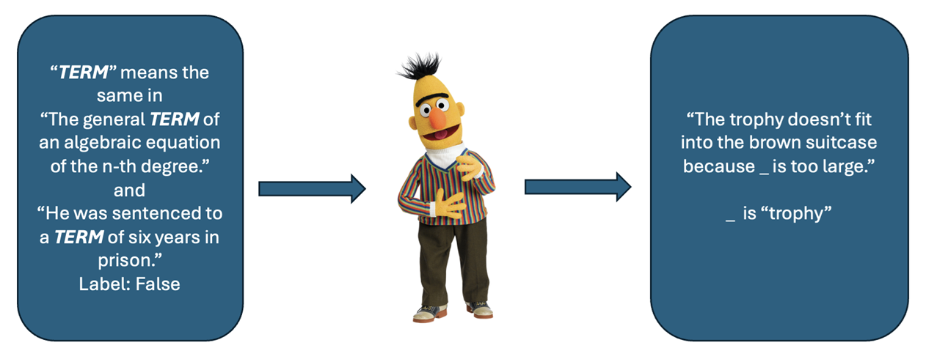
Problem Statement
This project aims to enhance encoders with statement-tuning, enabling them to generalize across multiple tasks and multiple languages in a zero-shot setting by using prompts(Statement templates) effectively without the need retraining on each specific task.
Encoders like BERT are primarily designed to represent text contextually rather than generate responses, so they don't naturally adapt to prompts for new tasks like summarization, text generation etc without training
Input: Unseen Tasks and Language Statements
Output: Identifies the correct statement from set of statements of unseen task
word sense disambiguation
encoder
Winograd
(coreference resolution)

Slide 3
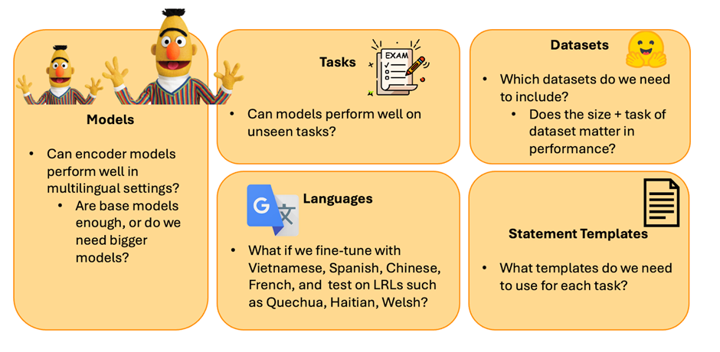
Motivation
Can ENCODER MODELS show similar performance in UNSEEN TASKS to LLMs in MULTILINGUAL settings?

Slide 4
Literature Review
The central goal of the research, which is to improve the adaptability of encoder models, such as BERT, in performing zero-shot tasks. Traditionally, encoder models like BERT require extensive task-specific fine-tuning to achieve high performance, which limits their flexibility and scalability.
To overcome this limitation, the paper introduces statement tuning, a novel method designed to enhance the adaptability of these models. By leveraging this technique, the encoder models can better understand and respond to prompts for new tasks without the need for extensive retraining.
In essence, statement tuning makes the model more versatile by enabling it to generalize and perform well on unseen tasks, thus enhancing the zero-shot learning capabilities of encoder models. This innovation reduces the dependency on labor-intensive fine-tuning processes for individual tasks, broadening the practical applications of encoder models in NLP.

Slide 5
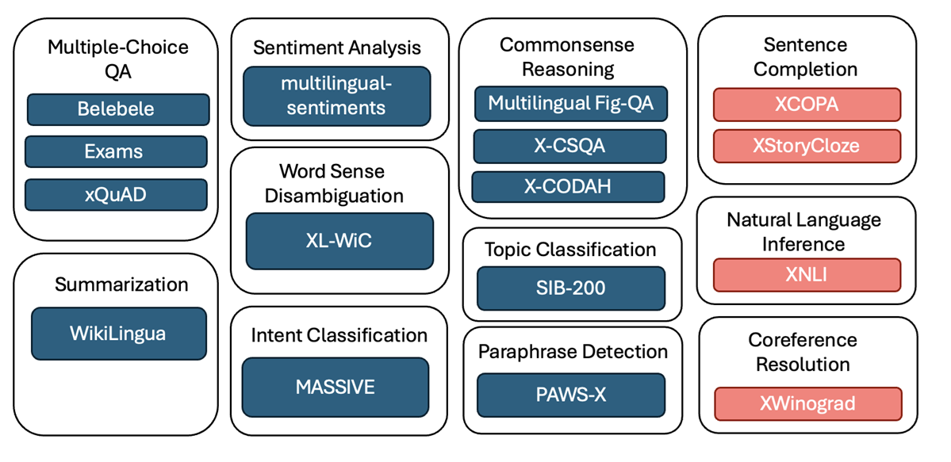
Dataset
Train Languages (11): English, French, Italian, German, Arabic, Swahili, Russian, Chinese, Hindi, Vietnamese, Indonesian
Test Languages (22): ar, bg, de, el, en, es, eu, fr, hi, id, jp, my, ru, pt, ru, sw, te, th, tr, ur, vi , zh

Slide 6
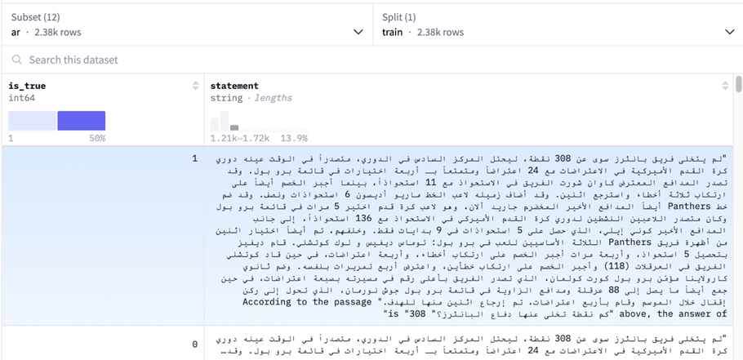
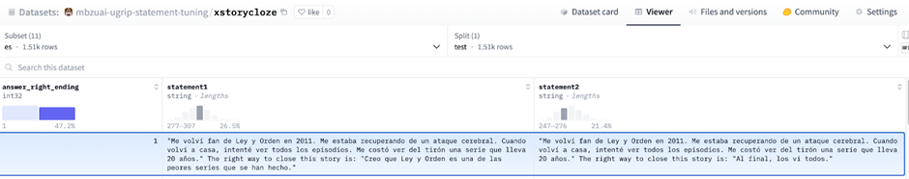
Truth Label
Statement
Datasets - Train, Validation
-> XQUAD
Datasets - Evaluation
Truth Label
Statement-1
Statement-2
Model chooses statement more likely be to true.
-> XStoryCloze
Total Training Dataset Size:
Total Evaluation/Test Dataset Size:

Slide 7

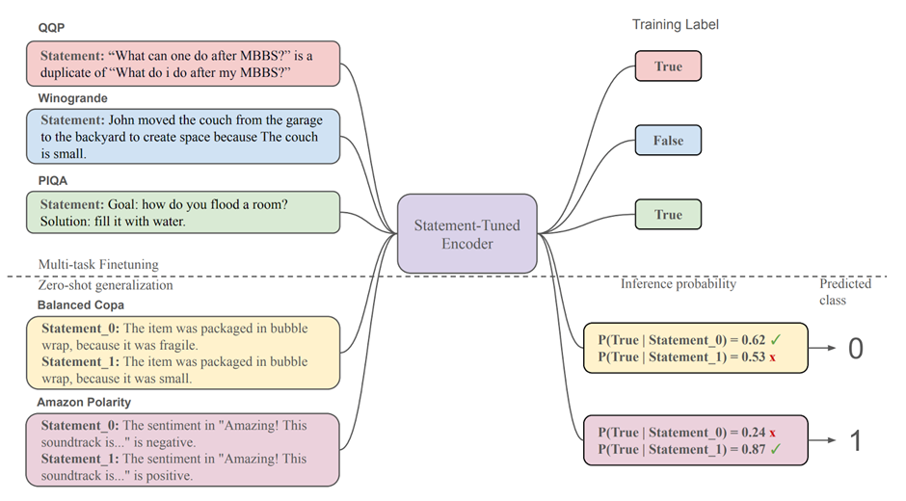
Method/Technique
Statement &
Truth Label
Give options & model chooses option most likely to be true

Slide 8
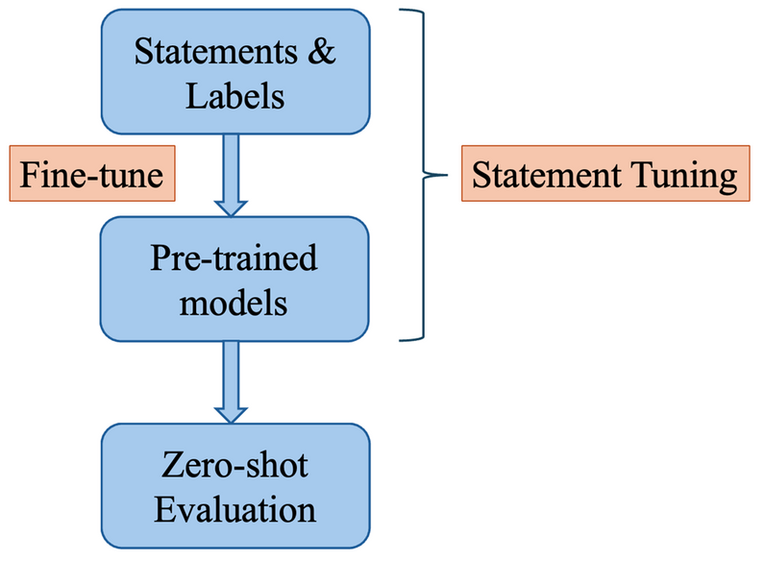
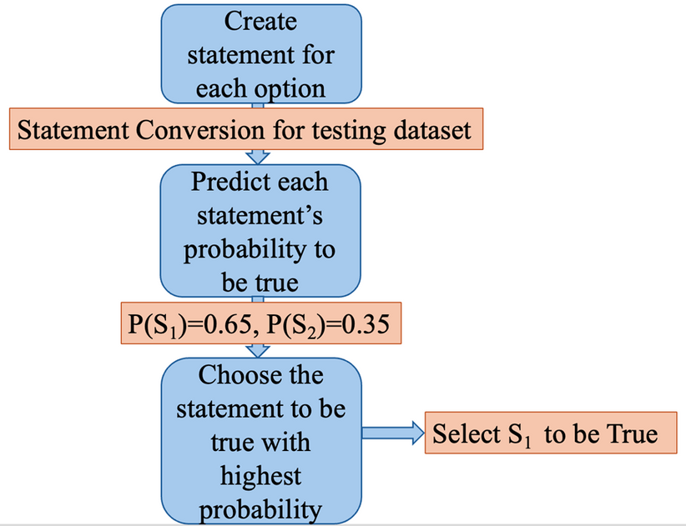
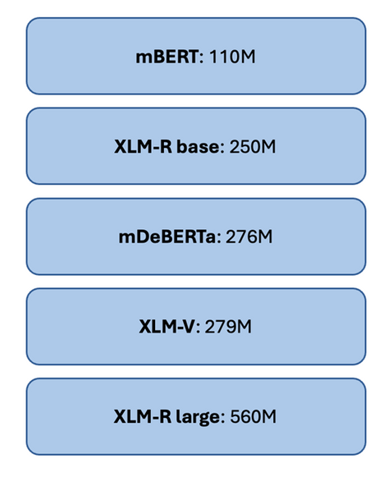
Methodology - Training
Methodology - Evaluation
Experiments:
We conducted Total 8 experiments:
1) Experimented on Total 4 Encoder Models as shown aside
2) For each model we carried out two experiments :- for Two Different Learning rate ( 1e-6 and 2e-6)
While Batch size=32

Slide 9
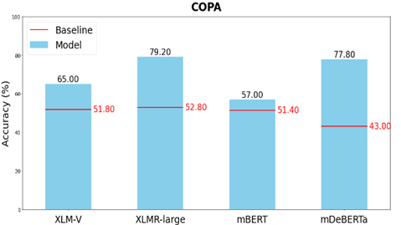
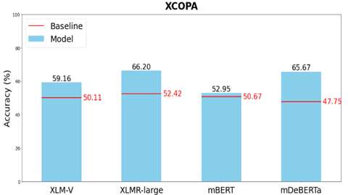
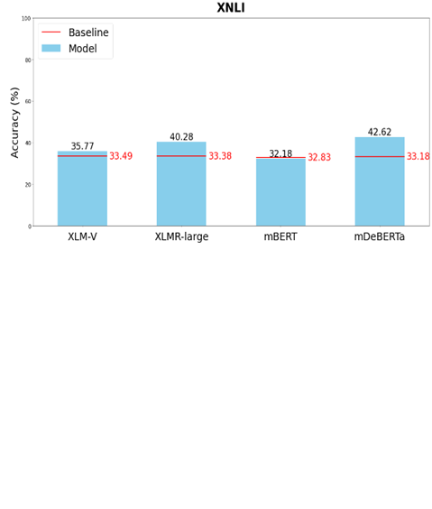
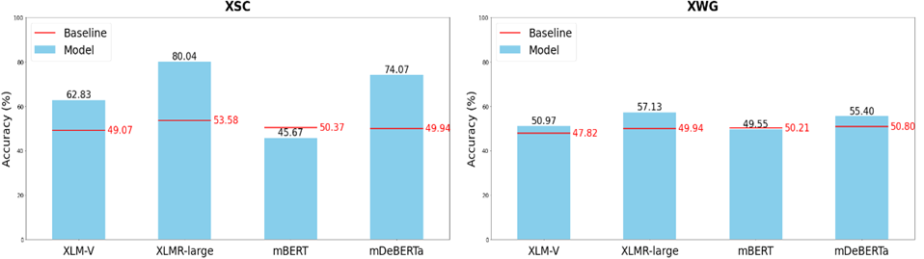
Results (Which Encoder model performs the best?)

Slide 10
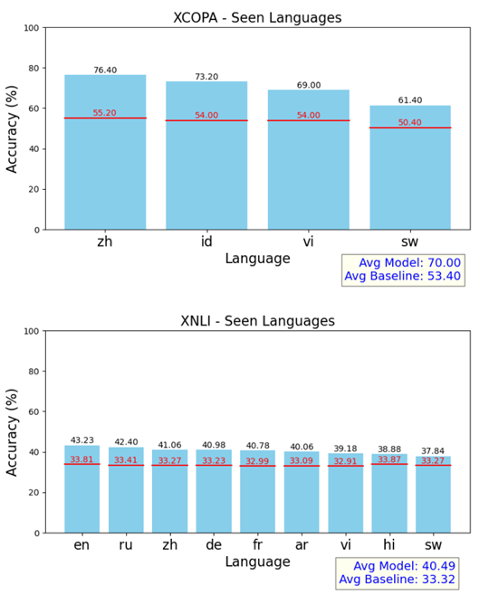
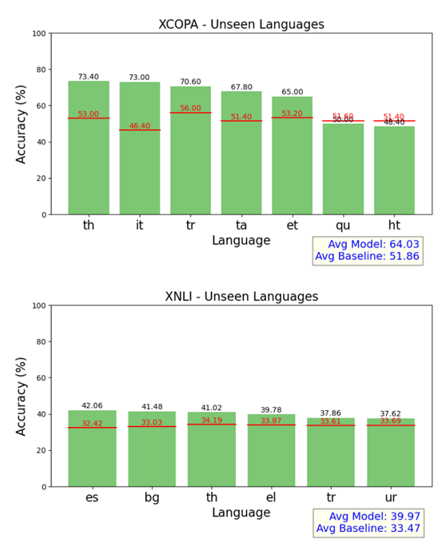
Results (Are models better with a certain task or language?)
XLMR-Large Model Average Accuracy Across Different Tasks and Languages

Slide 11
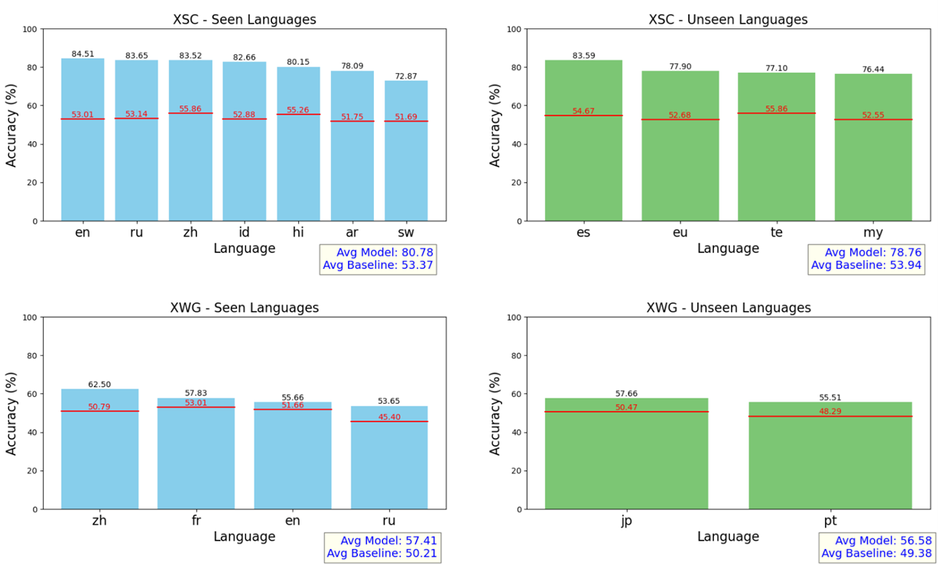
Results (Are models better with a certain task or language?)
XLMR-Large Model Average Accuracy Across Different Tasks and Languages

Slide 12
Analysis
XLMR-Large (560M) comes out to be the best encoder model in terms of results. But mDeBERTa (276M) performs comparably well (close to XLMR-large) in spite of being smaller in size.
We observe that XLMR-L performs well in unseen languages (specially in XCOPA and XSC tasks).
XNLI tasks proved to be a difficult task for encoder model- XLMRL to understand as compared to other tasks.
We observe that in XCOPA task, there is good generalization in Turkish language (~70%) whose none of family tree language was included in Training dataset. Whereas Quechuan and Haitian languages doesn’t generalize at all ( maybe because they are LRL’s).

Slide 13
Error analysis
<Report the incorrect outputs>
<try giving reasons>

Slide 14
Improvements over the paper
The paper has done statement tuning and evaluation on English only datasets. So it was Basically Multitask generalization in encoders. Whereas we added a Multilingual aspect to it. Instead of statement tuning a data of only english language, we made our training dataset as Multilingual comprising of 11 languages to see cross language generalization.
Paper evaluated on english only tasks like (Balanced COPA, MRPC, Emotion, Amazon Polarity, FigQA and Yahoo Answers Topics. While we evaluated on multilingual tasks like ( XCOPA, XNLI, XSC, X-Winograd)
So This way We added Cross Language Generalization Study to Paper

Slide 15
Learnings
We learned that Encoder-models has efficiency to perform well on zero shot settings
We learned about the template design ( different for each task). It’s a crucial part which plays important role in statement tuning.
We got a broad overview of multilingual cross generalization via this project. (Infact many experiments can be done to improve generalization)

Slide 16
Evaluation Scheme
Demo working- ((10) if not working or no GUI - (0))​
Literature understanding- (10)
Analysis- (10)
Improvement over paper- (10)
Note: Must have GUI, otherwise no mark will be given for demo.​

